Slide 1
E-food Insights Analyst Exercise
Konstantinos Christantonis
03/04/2023

Slide 2
Problem Description
We need to segment existing customers based on their frequency and order value.
Which segment could be a valuable target group for a Marketing campaign about “Breakfast” cuisine_parent?

Slide 3
Data Description
Available Data: January ’22 ~ 535k orders
~ 120k unique users / 46 cities / 4.38 orders in average per user
User_id | Order_Timestamp
City | Cuisine
Paid_cash (boolean) | Amount (float)

Slide 4
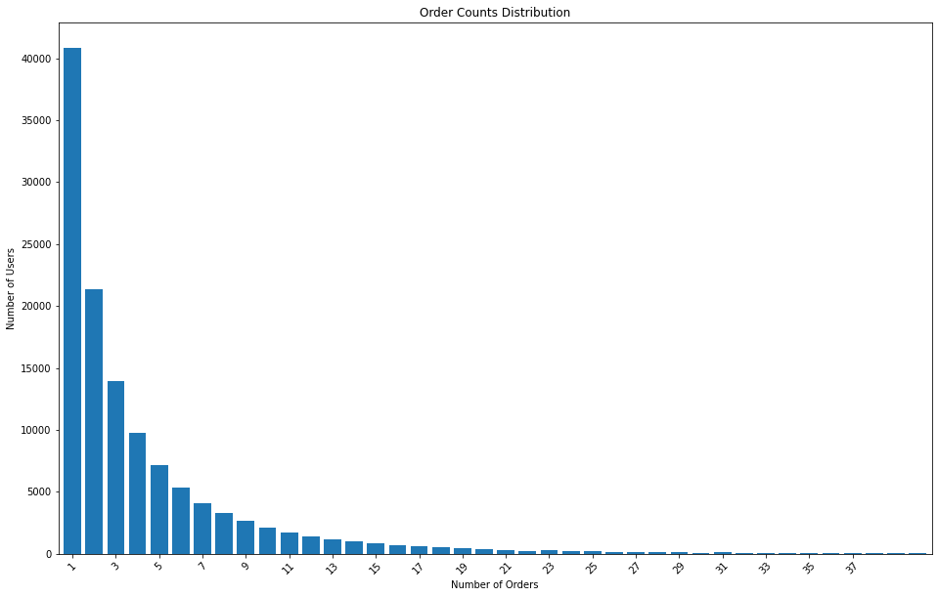
Segment by frequency
Find the number of orders each user has placed
Find the distribution of total orders per user

Slide 5
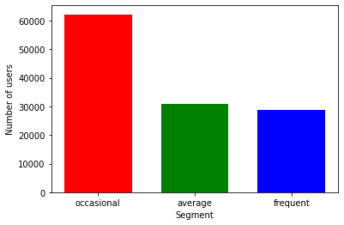
Segment by frequency
We use a quantile-based discretization method that aims to equally divide the data into the number of required bins.
It results into 3 bins
1st bin margins (1, 2] – 62196 users
2nd bin margins (2, 5] – 30894 users
3rd bin margins (5, 135] – 28853 users

Slide 6
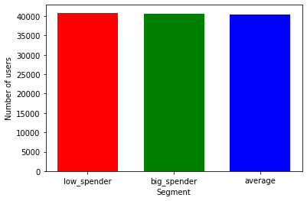
Segment by order value
We use the same method with 3 desired bins.
It results into 3 bins
1st bin margins (0.4, 14.8] – 40836 users
2nd bin margins (14.8, 36.8] –40628 users
3rd bin margins (36.8, 1351.5] –40479 users

Slide 7
Target group definition
Marketing wants to create more loyal customers based on the promotion of Breakfast cuisine. Therefore we aim to use the Segment by frequency
The target group users should meet the following criteria:
Occasional users (i.e not loyal, 1-2 orders)
Have not ordered Breakfast on January
Live in a city where other cuisines are more popular than Breakfast (expresses city culture)

Slide 8
Analyze filters
There are 15 cities where the Breakfast cuisine is not the most popular
There are ~66k users that have not ordered Breakfast on January
There are ~42k users that their most popular ordering city is found above
There are ~27k users that meet both above criteria
~18k of them were segmented as occasional
Extra tip! Out of 18k:
Λάρισα | Ιωάννινα | Άργος
Ορεστιάδα | Λέρος | Έδεσσα
Αίγινα | Νάξος | Οινόφυτα
Μύκονος | Βασιλικό | Αριδαία
Φιλιατρά | Ηγουμενίτσα | Άνδρος
LowSpender | 10553
AvgSpender | 6897
BigSpender | 708

Slide 9
Thank your for you attention

